Slide 1

THE THIEF’S STORY
By
Ruskin Bond

Slide 2


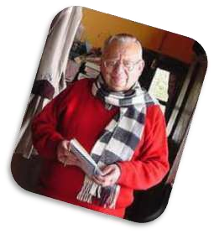
Ruskin Bond - Biography
• 19
th
May, 1934
Born
• Kasauli, Himachal Pradesh
• Now lives in Landour, Mussoorie
• The Room on the Roof
• The Night Train at Deoli
• Time Stops at Shamli
Famous
Novel
• Our Trees Still Grow in Dehra
• The Flight of Pigeons
• The Blue Umbrella
• 1999 : Padma Shri : Children’s Literature
• 1992 : Sahitya Akademi Award : Our
Trees Still Grow in Dehra
Awards
• 1957 : John Llewellyn Rhys Memorial
Prize : The Room on the Roof

Slide 3
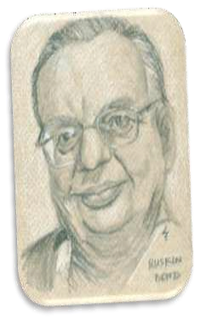
Style of Writing
He
has
stressed
more
on
the
local
elements of
Himalayas in his writings.
His writing style is distinct in a way that
it tries to make reader
understand the
landscape
and
character
through
carefully mastered words. Replete
with
unassuming humour and quiet wisdom,
his stories manifest a
deep love for
nature and children.

Slide 4
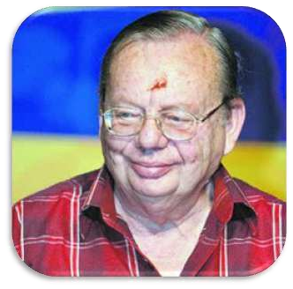
Occupation
He has been writing
stories for more than
forty years. He has
written short stories,
essays, novels and over
thirty books for children.

Slide 5

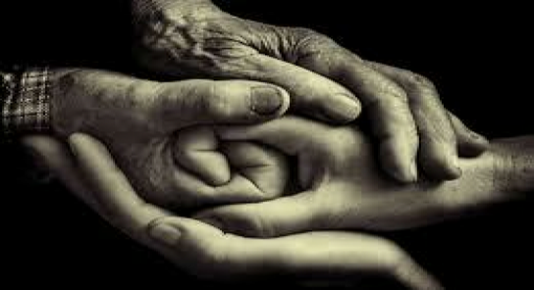
WHICH VALUE DO YOU THINK
TODAY’S SOCIETY NEED THE MOST?

Slide 6
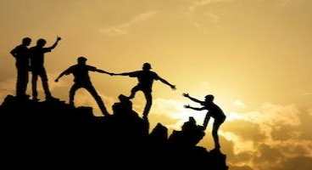
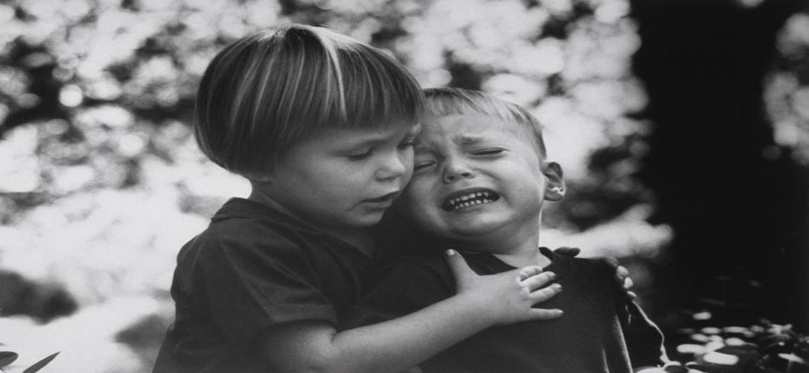

COMPASSION!!
Let’s make a difference in the
world we are living in…

Slide 7



Someone in need…?!?!
IS HE A STRANGER… ?
OR
SOMEONE LIKE ME..BUT IN AN UNFORTUNATE
SITUATION

Slide 8
Theme of the Story
The story deals with basic human values and relationships. It is
easier for a thief to rob a greedy man. It is difficult even for a thief
to rob a careless and honest person. Hari Singh did steal Anil’s
money but he couldn’t run away with it. He had no friends because
he regarded them to be trouble than help. The only person he
really knew was the man he had robbed. Moreover, Anil was ready
to educate Hari Singh. The thief’s conscience pricked him. He
came back to Anil and crept to his bed. He slipped the money
under the mattress from where he had stolen it a few hours ago.

Slide 9
Vocabulary
Trusts = relies on
betray = deceive, dupe
fairly = enough
lean =weak and thin
purpose = objective
wrestler = to strive by grappling
modestly = humbly
lied = to tell a lie
grunting = roaring
casually = purposelessly
Perhaps= probably
Stray= wandering
patted= stroked

Slide 10
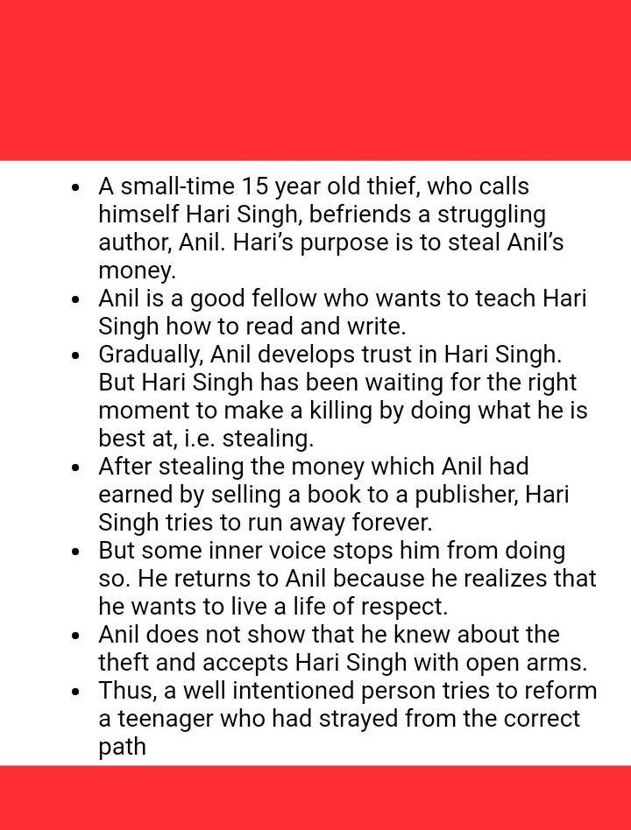
SUMMARY

Slide 11

Main Points of the Story
Anil was a young writer. He was living his life very carelessly.
He was writing for the magazines and earning the money to run
his life.
One day Anil was watching the wrestling match.
Hari best knew how to make unknown person a friend.
He used an old formula to flatter the person. Hari stayed with Anil.
Anil promised him that he would teach him how to write and add
numbers.
He also taught him how to cook tasty food.
Daily Hari Singh was going to buy daily needs and had profit of
one rupee daily.
Anil knew it but he did not mind it. Both were living together
happily.

Slide 12
Main Points of the Story
One month passed, Hari Singh did not perform his
business.
One day he saw Anil had bought a bundle of notes.
He saw him to put them under the mattress. As Hari
saw the bundle of notes, his evil spirit awakened in
his mind and he decided to rob Anil that night.
After taking dinner Anil slept peacefully.
Hari could not sleep, he woke up. He crept to the bed
and slipped his hand under the mattress.

Slide 13
Main Points of the Story
He found the notes and ran away on the road.
Hari Singh made up his mind that he would directly
go to the railway station and would catch the
Lucknow Express.
He thought that Anil would not catch him if he ran
away from the city.
Hari Singh reached the railway station, Lucknow
Express was about to go.

Slide 14
Main Points of the Story
Suddenly the good spirit called him. The inner voice
told him not to betray the faith of Anil.
The train was moving but
Hari did not dare to catch it. He was remembering
the innocent face of Anil. When Hari Singh thought
that what would Anil think about him.
Anil would not worry about the money but he might
feel bad that a man had broken his faith.

Slide 15
Main Points of the Story
There was conflict in the mind of Hari Singh. He
did not want to loose faith of Anil. Because he
knew that Anil was a simple man.
Moreover Anil was teaching him how to write and
add numbers which could change his life.
He could become a respected person in the
society.

Slide 16
Main Points of the Story
He left the railway station.
He came to the maidan and sat on the bench.
Just then heavy rain started. It was the month of
November. Chill wind started blowing.
He felt more uncomfortable as he had cheated an
innocent person.
His shirt and pyjamas stuck to his body because it
were wet due to the rain.

Slide 17
Main Points of the Story
Then he went to the Clock Tower to save from the rain.
He sat there under the tower.
Suddenly he remembered his notes. He searched for it and found that
all the notes were wet.
He reached home and stealthily went into the room where Anil was
sleeping.
He crept again and secretly put back money under the mattress.
The next day Anil woke up, prepared tea for Hari and himself. He
handed over fifty rupees note to Hari and told him that he would be
regularly paid now.
Hari took the note and found that it was still wet.
He understood that Anil knew about the last night episode.

Slide 18
Characters
1.Hari Singh: Hari Singh is a small-time thief. His real name is not
Hari Singh, he keeps on changing names to escape from police. His
Modus operandi is that he earns the trust of people and then robs
them and Ĉees. When he sees Anil, he thinks of robbing him and
hence approaches him and asks for work. Anil, being a simple person
lets his work and even starts teaching him how to cook. Had Singh
is delighted when Anil starts teaching him to write as he plans to rob
on a larger scale. Had steals a little money daily when he goes to buy
the daily groceries, and one day when he gets a chance he
steals money from Anil and runs away. But at the station, he has a
change of heart and comes back.
He is now happy and contented to live with Anil.

Slide 19
Characters
2. Anil: Anil is a kind, simple and easy-going young man. He is tall and lean stature and has interest in sports like wrestling. He is not very rich and cannot afford to employ him as a cook. He has the patience and goodness to not only teach Had to cook but also to read, write and add numbers. Though he knows about Hari’s stealing of little bits of money from the groceries, he ignores this fact.

Slide 20
